Slide 1
GEOGRAPHY AND TIMESTAMP OF SPAM TWEETS(Determining the type of tweets, location, datetime, Positive and Negative tweets)
Group 7 Team Members:
Mounika Nuchu
Anitha Nari
Monisha Mahitha boddu
Vijayalakshmi Peppala

Slide 2
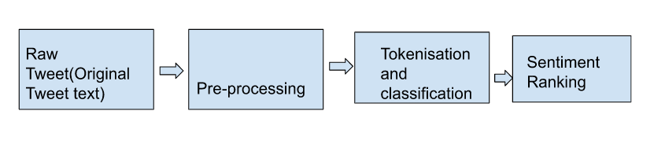
Workflow

Slide 3
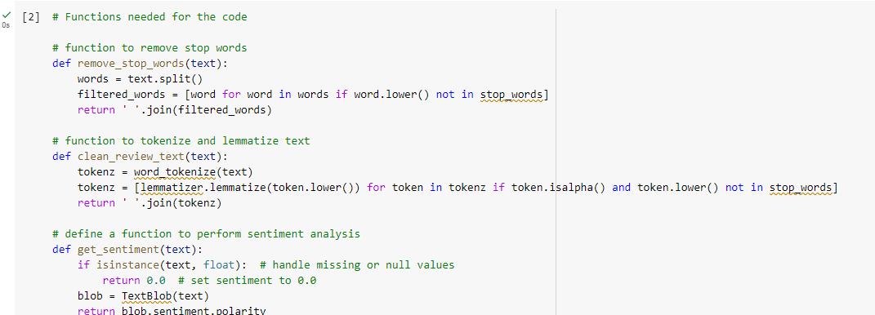
Functions for code, tokenize, sentiment Analysis

Slide 4
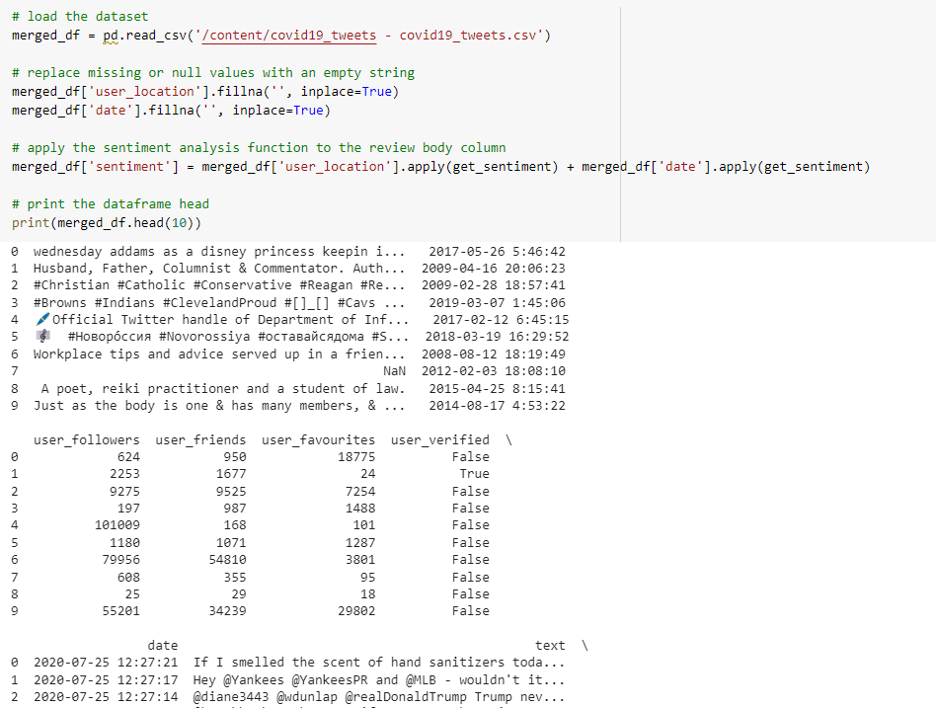
Loading of Dataset

Slide 5
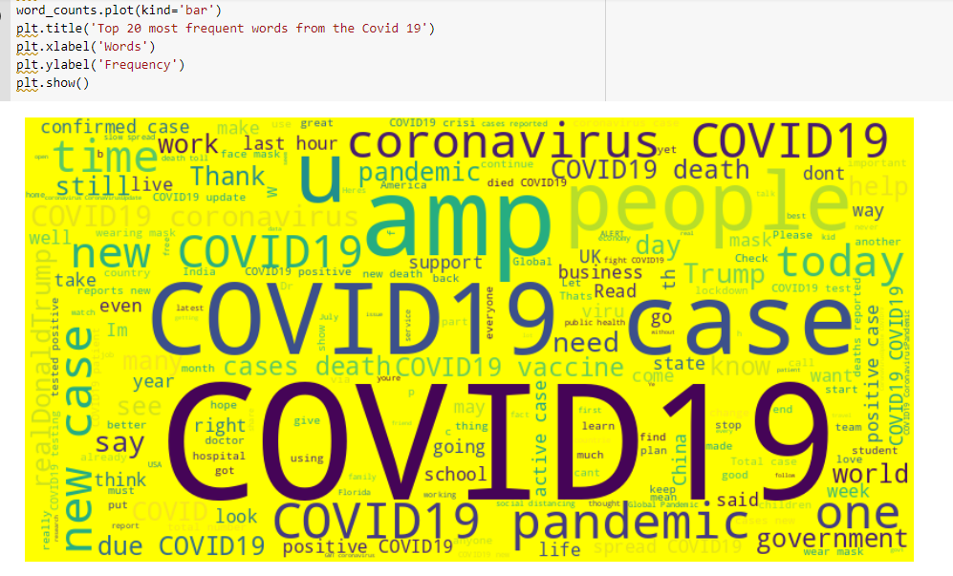
Cleaning of tweets for further analysis and generating cloud

Slide 6
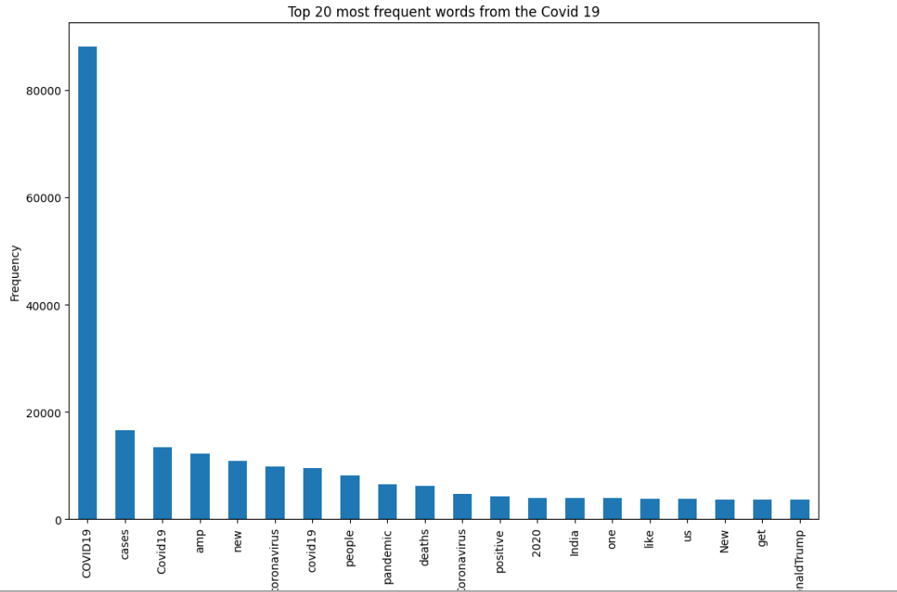
Generating Bar graph

Slide 7
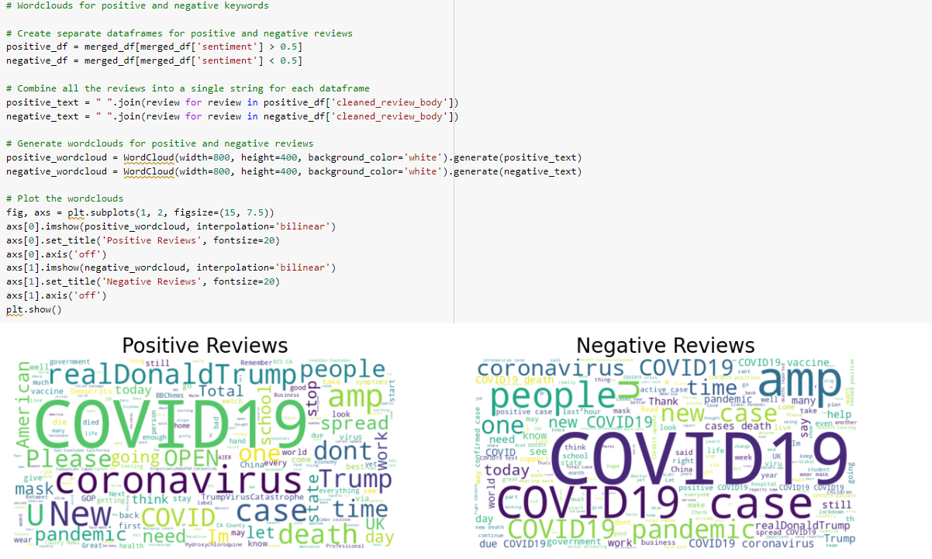
Positive and negative tweets

Slide 8
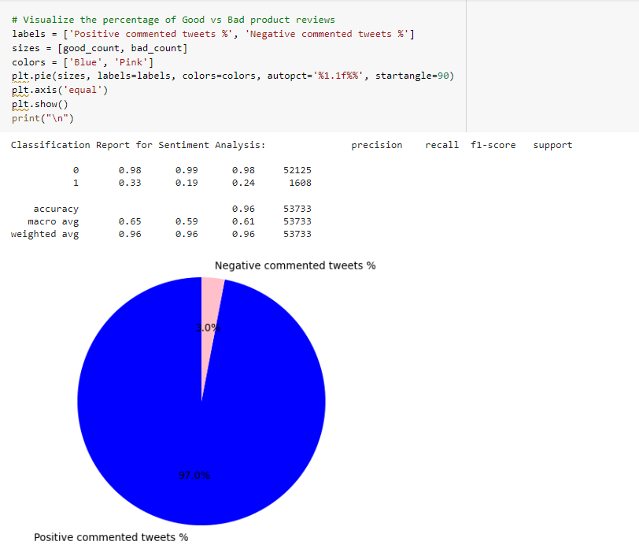
Generating Positive and negative tweets in Pie chart

Slide 9
Features
A context-dependent sentiment classifier by combining the sentiment analysis of various authors, user locations, user timestamp, and dates
as determined by tagged Data collected from Twitter with conventional based on words sentiment different methods of classification.

Slide 10
Thank You

